Slide 1
The role of ATP8B1 (rs766737165) in the susceptibility to gallstone disease in Pakistani population
Syed Muhammad Ali Shirazi (SP22-BSO-049)
Ahmad Malik (SP22-BSO-032)

Slide 2
DNA GEL Electrophoresis Results
Results

Slide 3
ATP8B1 (rs766737165)
16th October, 2025
Annealing temperature: 53
Number of samples: 7
1: C63
2: C64
3: C65
4: C66
5: C68
6: C69
7: C70
 | Reaction Mixture
Master Mix | 8.5 x 8 | 68
Outer Forward | 0.5 x 8 | 4
Outer Reverse | 0.5 x 8 | 4
Inner Forward | 0.7 x 8 | 5.6
Inner Reverse | 0.7 x 8 | 5.6
Water | 7.1 x 8 | 56.8
DNA = 2

Slide 4
NO bands appeared

Slide 5
ATP8B1 (rs766737165)
16th October, 2025
Annealing temperature: 53
Number of samples: 7
1: C63
2: C64
3: C65
4: C66
5: C68
6: C69
7: C70
 | Reaction Mixture
Master Mix | 8.5 x 8 | 68
Outer Forward | 0.5 x 8 | 4
Outer Reverse | 0.5 x 8 | 4
Inner Forward | 0.7 x 8 | 5.6
Inner Reverse | 0.7 x 8 | 5.6
Water | 7.1 x 8 | 56.8
DNA = 2

Slide 6
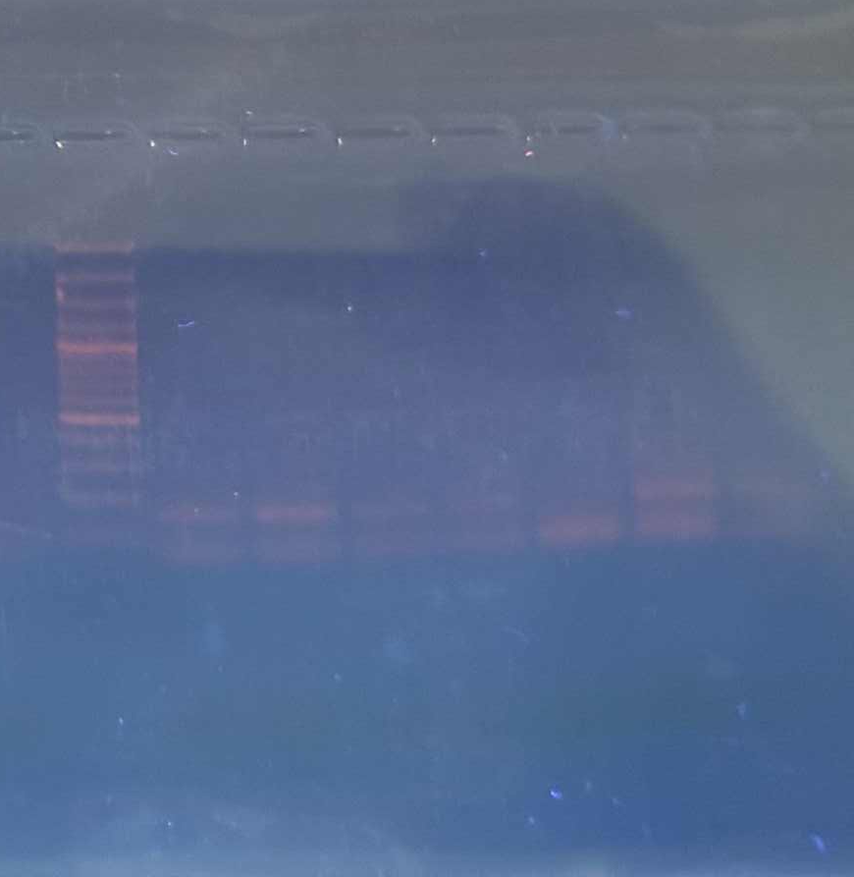
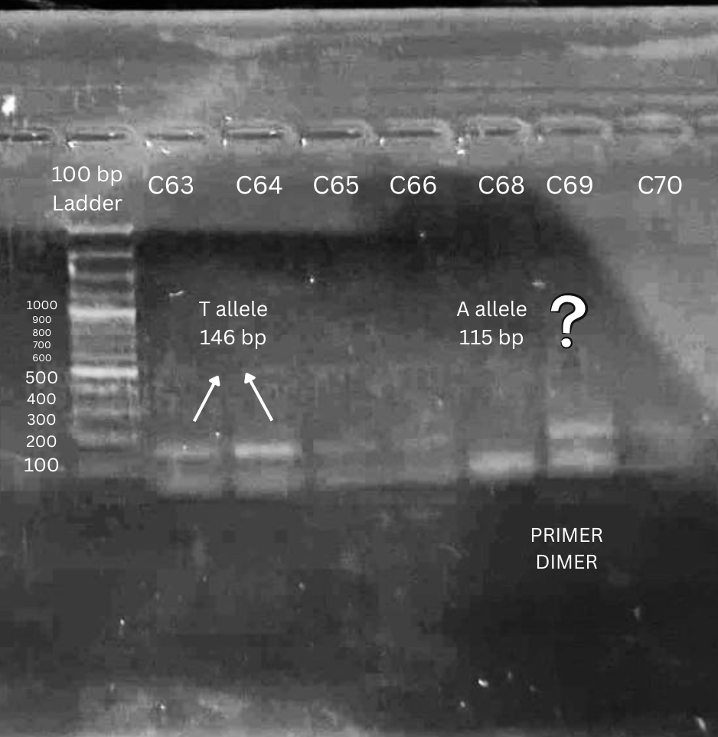
Normal view
Contrast & Labelled

Slide 7
ATP8B1 (rs766737165)
11th November, 2025
Annealing temperature: 53
Number of samples: 7
1: D278
2: D283
3: D286
4: D290
5: D291
6: D297
7: D298
 | Reaction Mixture
Master Mix | 8.5 x 8 | 68
Outer Forward | 0.5 x 8 | 4
Outer Reverse | 0.5 x 8 | 4
Inner Forward | 0.9 x 8 | 7.2
Inner Reverse | 0.9 x 8 | 7.2
Water | 7.1 x 8 | 53.6
DNA = 2

Slide 8
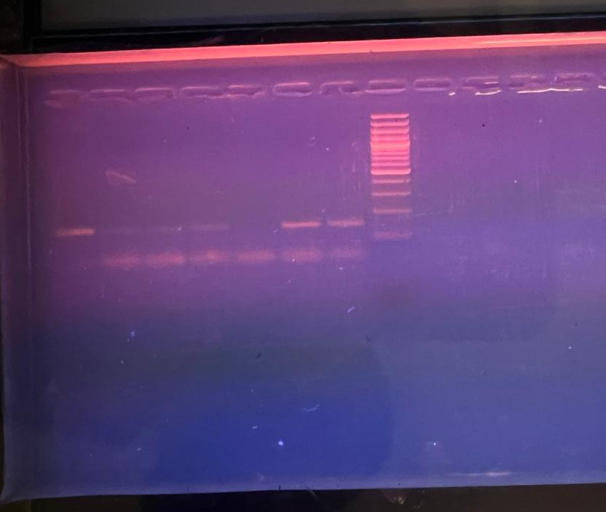
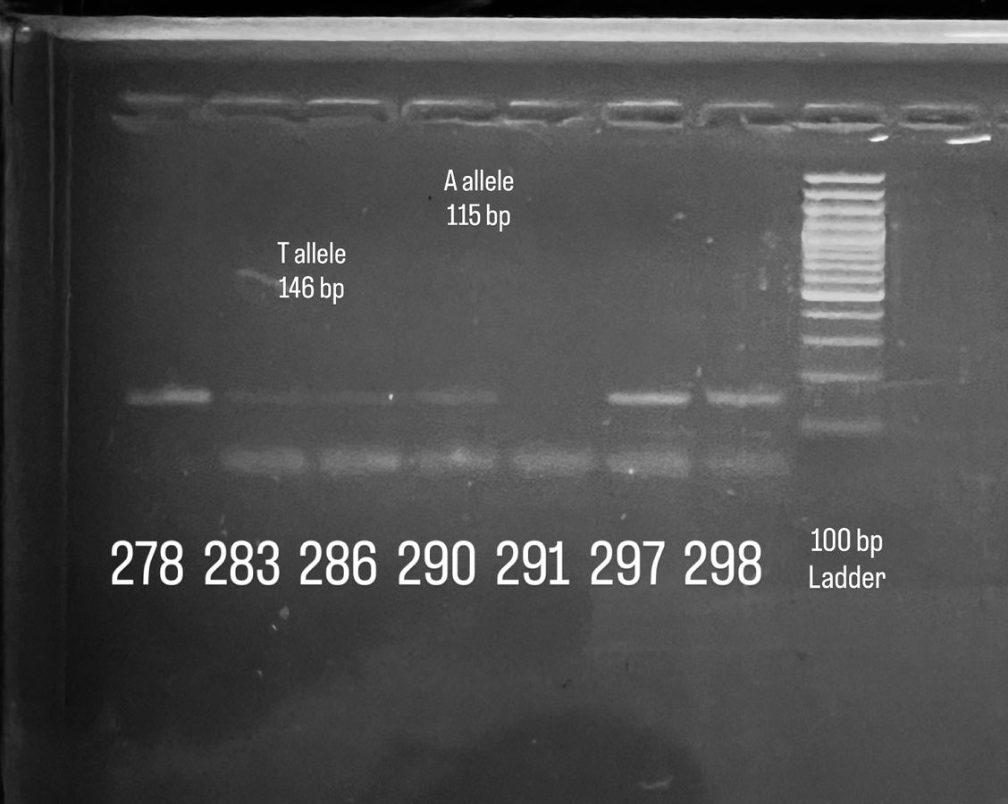
Normal view
Contrast & Labelled

Slide 9
ATP8B1 (rs766737165)
18th November, 2025
Annealing temperature: 52
Number of samples: 9
1: D299
2: D310
3: D311
4: D314
5: D318
6: D333
7: D336
8: D337
9: D338
 | Reaction Mixture
Master Mix | 8.5 x 10 | 85
Outer Forward | 0.5 x 10 | 5
Outer Reverse | 0.5 x 10 | 5
Inner Forward | 0.9 x 10 | 9
Inner Reverse | 0.9 x 10 | 9
Water | 6.7 x 10 | 67
DNA = 2

Slide 10
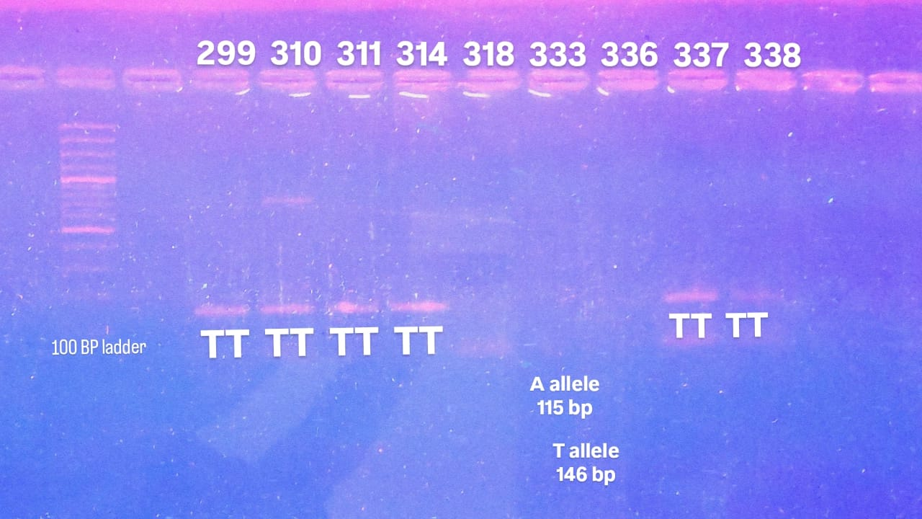

Slide 11
ATP8B1 (rs766737165)
18th November, 2025
Annealing temperature: 52
Number of samples: 10
282
283
286
290
291
293
296
297
298
346
 | Reaction Mixture | For 11 samples
Master Mix | 7 x 11 | 77
Outer Forward | 0.5 x 11 | 5.5
Outer Reverse | 0.5 x 11 | 5.5
Inner Forward | 0.9 x 11 | 9.9
Inner Reverse | 0.9 x 11 | 9.9
Water | 3.2 x 11 | 33.2
DNA = 2

Slide 12
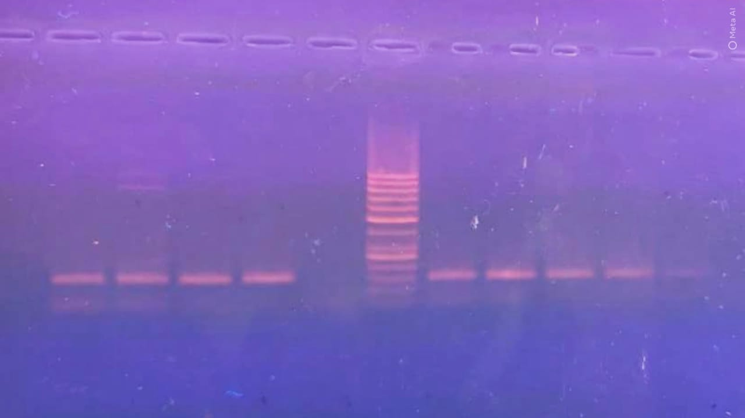
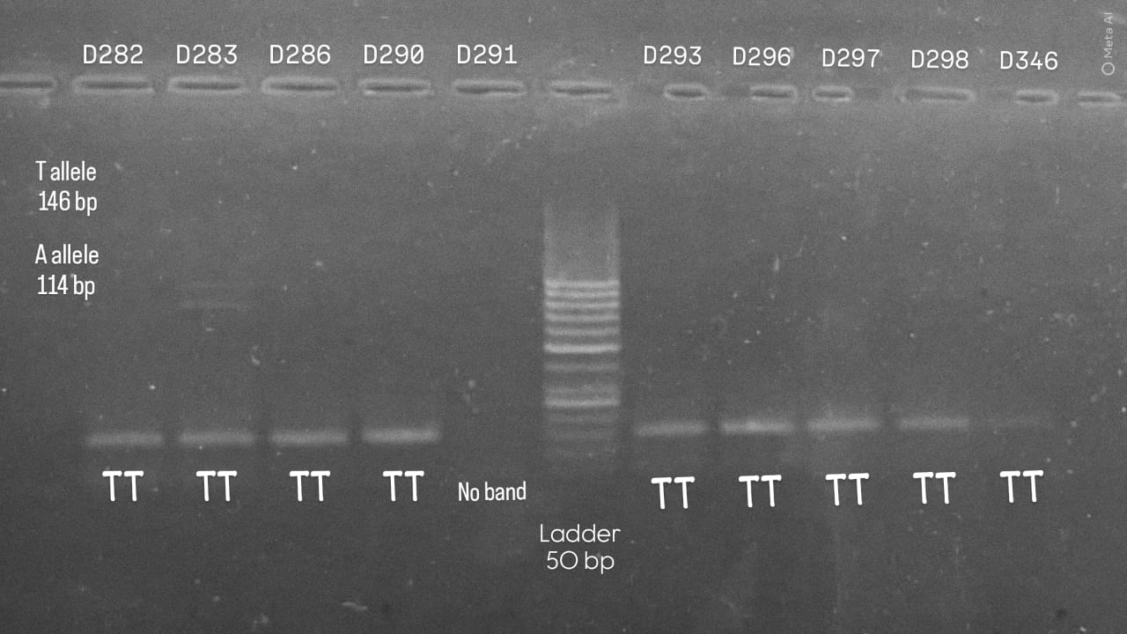
Normal view
Contrast & Labelled

Slide 13
ATP8B1 (rs766737165)
25th November, 2025
Annealing temperature: 53
Number of samples: 11
008
009
014
043
G-110
G-111
G-113
G-116
G-128
272
 | Reaction Mixture | For 11 samples
Master Mix | 6 x 11 | 66
Outer Forward | 0.7 x 11 | 3.3
Outer Reverse | 0.7 x 11 | 3.3
Inner Forward | 0.35 x 11 | 7.7
Water | 3.35 x 11 | 40.7
DNA = 1

Slide 14
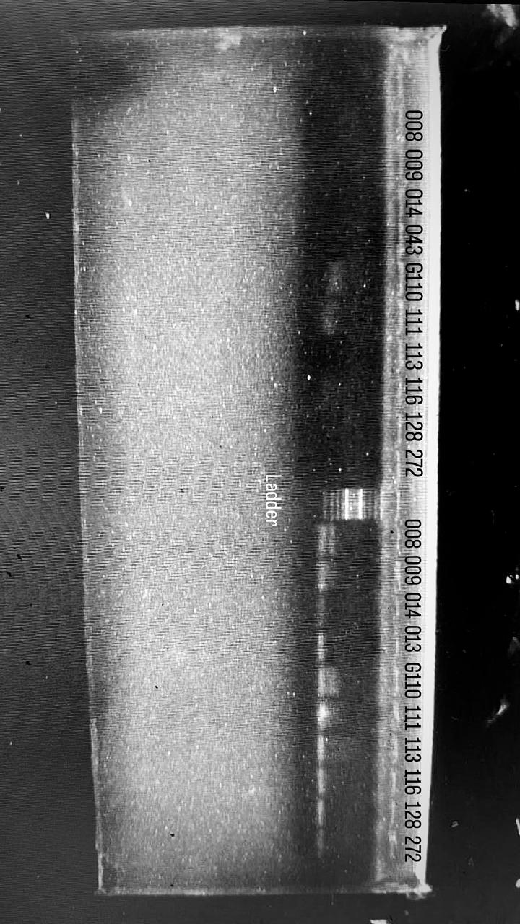
Samples with Inner Reverse primer
for A allele
Samples with Inner Forward primer
for T allele

Slide 15
ATP8B1 (rs766737165)
27th November, 2025
Annealing temperature: 53
Number of samples: 11
110
110
014
274
281
282
290
286
316
318
322
 | Reaction Mixture | For 11 samples
Master Mix | 6 x 11 | 66
Outer Forward | 0.3 x 11 | 7.7
Outer Reverse | 0.3 x 11 | 7.7
Inner Forward | 0.35 x 11 | 3.85
Inner Reverse | 0.35 x 11 | 3.85
Water | 3.7 x 11 | 40.7
DNA = 1

Slide 16
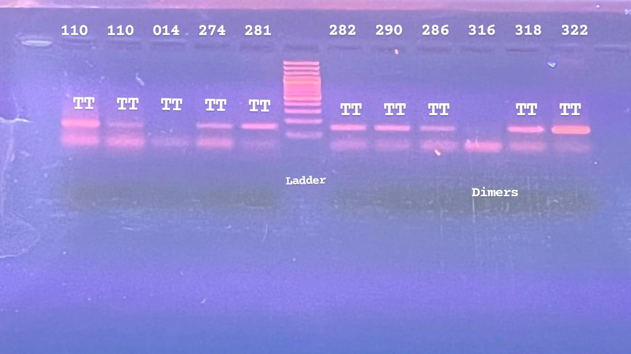

Slide 17
ATP8B1 (rs766737165)
1st Dec, 2025
Annealing temperature: 52
Number of samples: 10
013
275
276
277
313
328
341
344
346
349
 | Reaction Mixture | For 11 samples
Master Mix | 6 x 11 | 66
Outer Forward | 0.7 x 11 | 7.7
Outer Reverse | 0.7 x 11 | 7.7
Inner Forward | 0.3 x 11 | 3.3
Inner Reverse | 0.3 x 11 | 3.3
Water | 3 x 11 | 33
DNA = 1

Slide 18
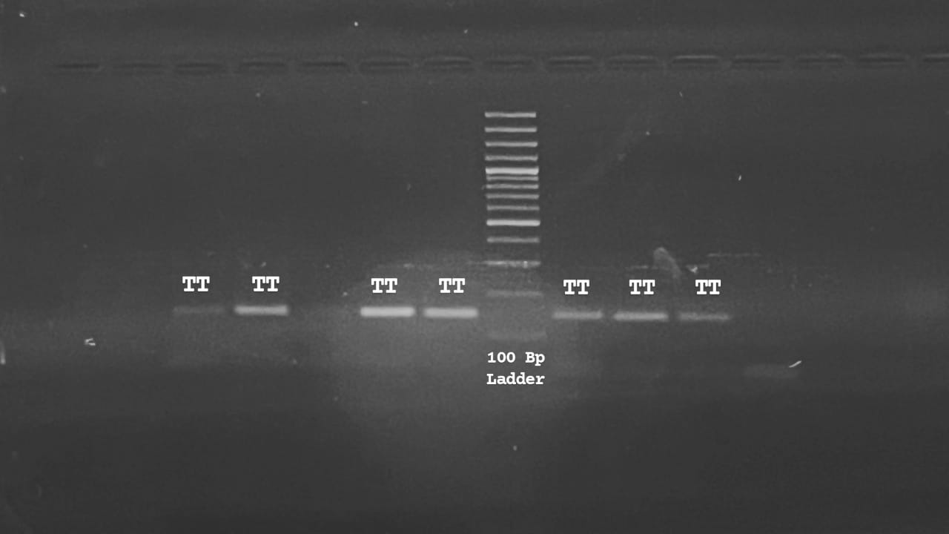
013 275 276 277 313
328 341 344 346

Slide 19
ATP8B1 (rs766737165)
2nd Dec, 2025
Annealing temperature: 52
Number of samples: 10
354
355
356
358
359
373
401
403
409
411
 | Reaction Mixture | For 11 samples
Master Mix | 6 x 11 | 71.5
Outer Forward | 0. x 11 | 5.5
Outer Reverse | 0. x 11 | 5.5
Inner Forward | 0. x 11 | 3.3
Inner Reverse | 0. x 11 | 3.3
Water | 3. x 11 | 31.9
DNA = 1

Slide 20


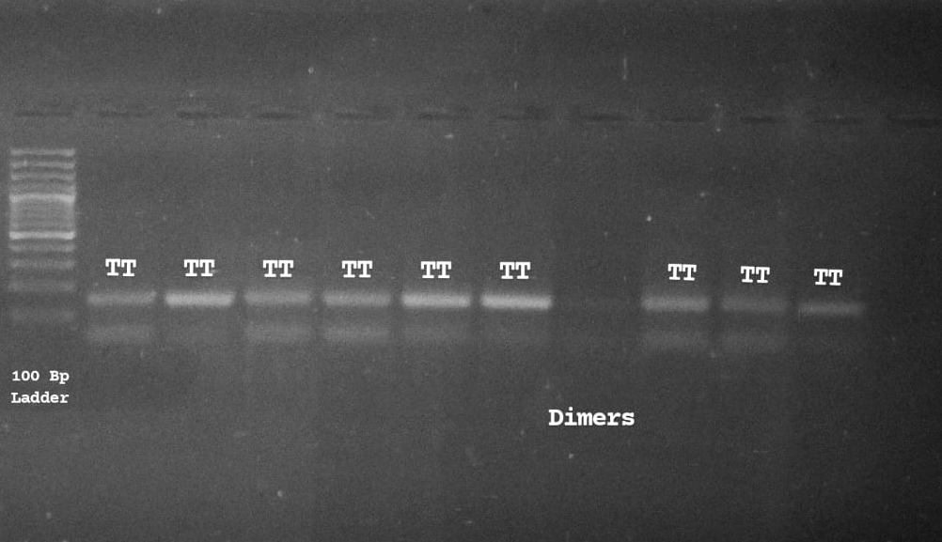

354 355 356 358 359 373 401 403 409 411

Slide 21
ATP8B1 (rs766737165)
3rd Dec 2025
Annealing temperature: 53
Number of samples: 21
304
306
308
331
332
336
337
338
340
345
 | Reaction Mixture | For 22 samples
Master Mix | 6 x 22 | 132
Outer Forward | 0.3 x 22 | 6.6
Outer Reverse | 0.3 x 22 | 6.6
Inner Forward | 0.5 x 22 | 11
Inner Reverse | 0.5 x 22 | 11
Water | 3.4 x 22 | 74.8
DNA = 1
350
353
355
356
357
358
359
360
365
366
372

Slide 22
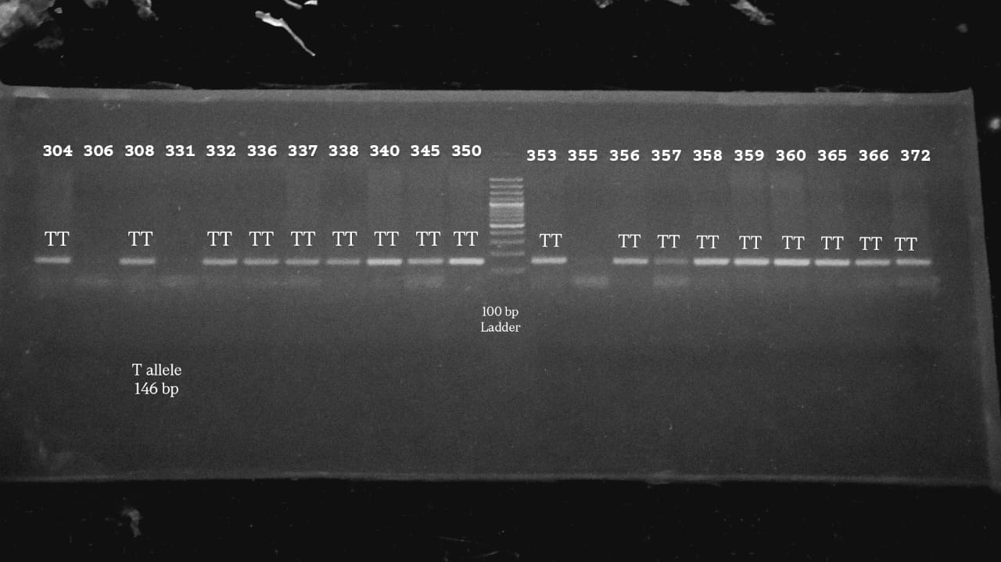
354 355 356 358 359 373 401 403 409 411

Slide 23
ATP8B1 (rs766737165)
5th Dec 2025
Annealing temperature: 53
Number of samples: 20
101
103
104
108
109
110
111
112
114
115
 | Reaction Mixture | For 22 samples
Master Mix | 6 x 22 | 132
Outer Forward | 0.3 x 22 | 6.6
Outer Reverse | 0.3 x 22 | 6.6
Inner Forward | 0.5 x 22 | 11
Inner Reverse | 0.5 x 22 | 11
Water | 3.4 x 22 | 74.8
DNA = 1
117
118
119
121
122
124
128
131
132
133

Slide 24
